Slide 1

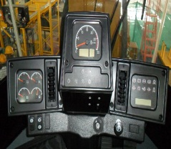
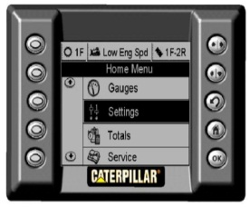
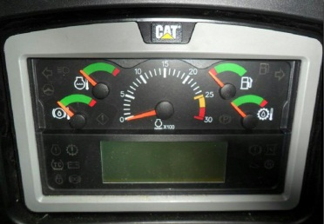
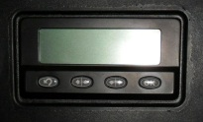
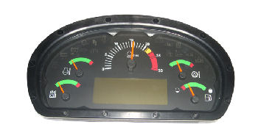
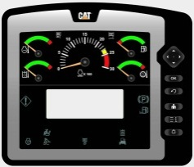
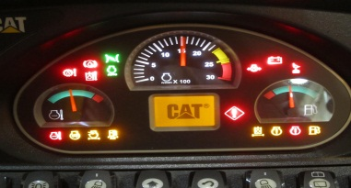
12-Mar-2018
Display System Software

Slide 2
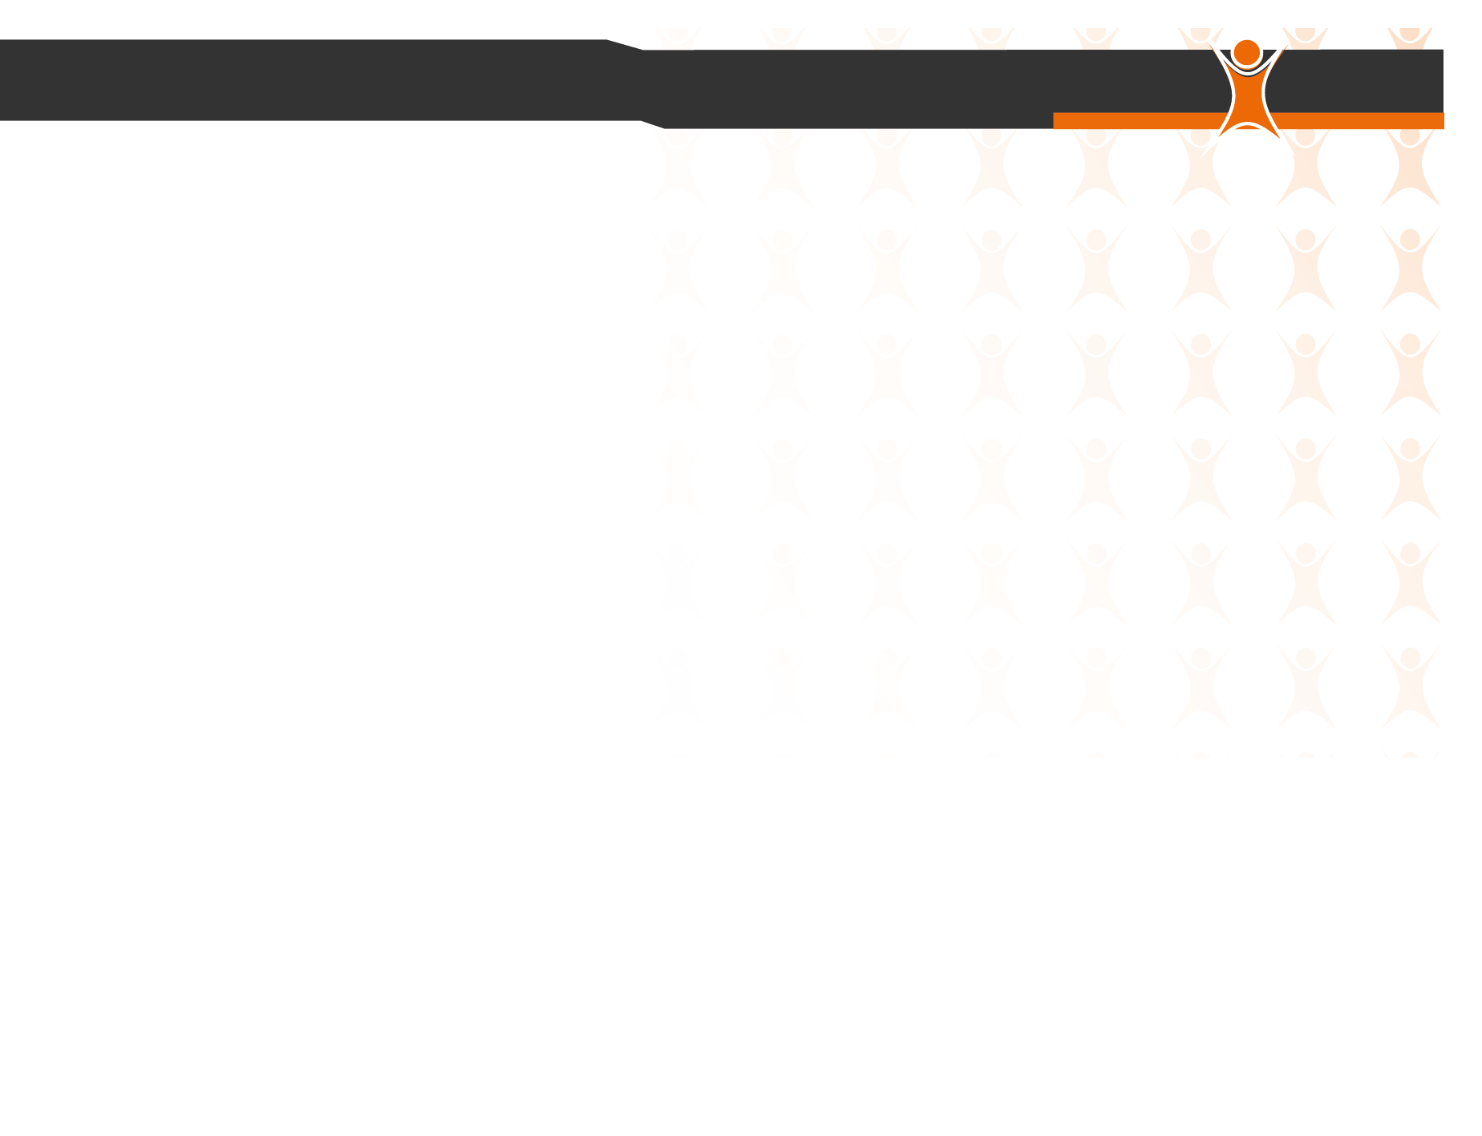
Agenda:
1. System Block Diagram 2. Advisor & Messenger Application 3. Display System Process 4. Display Validation Process 5. Display Team Structure 6. Advisor & Messenger Status

Slide 3
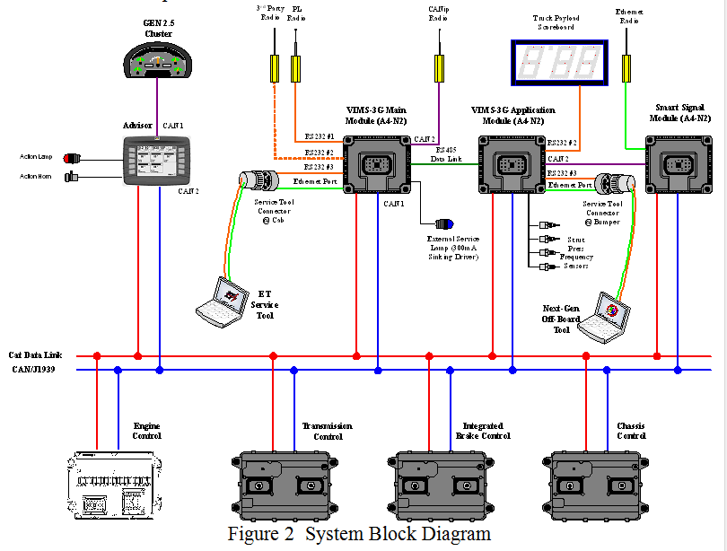
Advisor & Messenger
Controller: Motorola 68376 32-bit
OS: VRTX
Build Env: Microtek

Slide 4

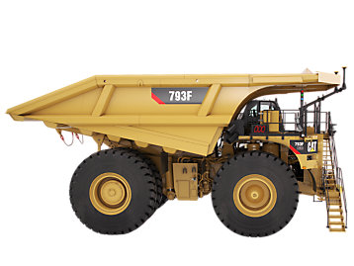



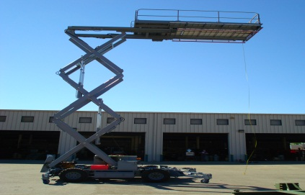
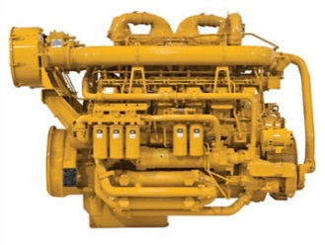
Advisor & Messenger
Advisor - Application
Quarry & Construction
- Titan – 770G, 772G, 773G, 775G, 777G T4F & LRC
- Atlas – 773F,775F,777F
Large Mining Truck
- Checkmate 1 – 793F & 797F
- Checkmate 2 - 793 FAC & 795FAC
- Phoenix - MT4400 & MT5300
- AMT – 793F & 797F
Large Wheel Loader
- LWL 992/ 854
- LWL 993K
- LWL 994
Large Track Type Tractor
- D8 to D11 T4F
Pavers
- AP 6XXD ,AP5XXE & AP10XXE
Engine
- G3500 & G3516B
Messenger - Application
Quarry & Construction
- Titan – 770G, 772G T4F & LRC
- Atlas - 773F & 775F
Motor Grader
- MG M1 – 12,14,16,120,140,160M Series
- MG M2 – 12,120,140,160M Series
TPMS (Tire pressure Monitor System)
Medium Wheel Loader(MWL) & Large Wheel Loader (LWL)
Marine
Track Type Loader (TTL)
Engine
- 3300
Scissor Lift
Notes:
Technical information

Slide 5
Display System Process
CRMs
CRM 1,CRM 2,….CRM N
Change Request Management(CRM) is the display requirement which is posted by customer. Our display sub system Engineer will get notification of this entry.
Issue Entry
Issue 1, Issue 2 …. Issue N
Display Sub System Engineer will post a Issue entry based on CRM content and All team members will get notification of this entry.
Activity
Task 1,Task 2 ….Task N
Architech will analyze the requirement and will create activity for team members. He should do the Estimates and Planning for both development and Testing.
Release Card
Once Development & Validation are completed, the software is ready to release. Developer will attach the delivery file (fls or fl2), Release notes and Test report in Release card . Architech will verify the release check list and will do the software release. We subscribe all customers in release card.

Slide 6

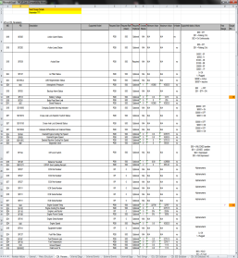
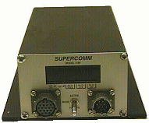


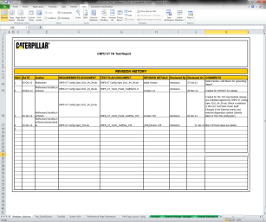

Validation Process
Requirements
(Parameter list, EDDT codes)
Superlink Simulation
(User Controlled)
Physical Data link
Parameters simulated manually
User presses button to navigate through screens
Test Reports
Reports generated
manually after visual inspection
Visual inspection of screen data
- Manual Process

Slide 7
Display Team Structure
Saravanan
Developers
Dinesh Kannan
Shivaji
Test Engineer
Rajeswar Rao
Dinesh and Shivaji both have started to work activities from last month onwards.
They can able to develop the software individually with help of my high level guidance.
As per my knowledge, still they have to learn the process (Issue list, Activity and release card updates,etc.,).
For your information, Gurram Bharath kumar, Phaneendra and Mohan rao are reporting to Ravi Kiran.
I required one test engineer as a shadow.

Slide 8
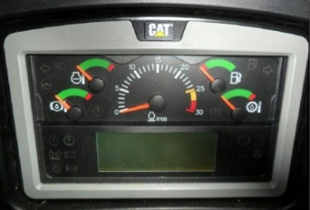
Advisor & Messenger Status
Program Scope:
Complete Software Accountability
Sub System Specification Development
Application and Configuration Development
Software Validation
Complete Flash File Accountability
Next Key Program Milestone:
Messenger petro LFC | LMT - Phoenix | Messenger D7R II | LWL | Messenger MG M1 & M2
March’18 | March ’18 | March’18 | April’18 | April’18
P | Q | V | C
Accomplishments :
Delivered 2 Concept Releases in Advisor & 1 concept in Messenger program.
Checkmate –II (Advisor)
773GC(Advisor)
TTL Program (Messenger)
Waiting for 773GC program feedback
Focus Areas :
Waiting for LWL requirement.
LMT Prod Releases.
Waiting for MG requirements.
Opportunities & Risks:
Need to work On SIL Automation.

Slide 9
THANK YOU

